Slide 1

Week 3 Inferential Statistics (2) Correlation and Chi Square
Prof. Ah-Lian Kor

Slide 2
Correlation
What is it?
Co (between) , relation
Measures the strength of the linear relationship between two quantitative (or numerical) variables
Examples: height and weight; etc.....

Slide 3
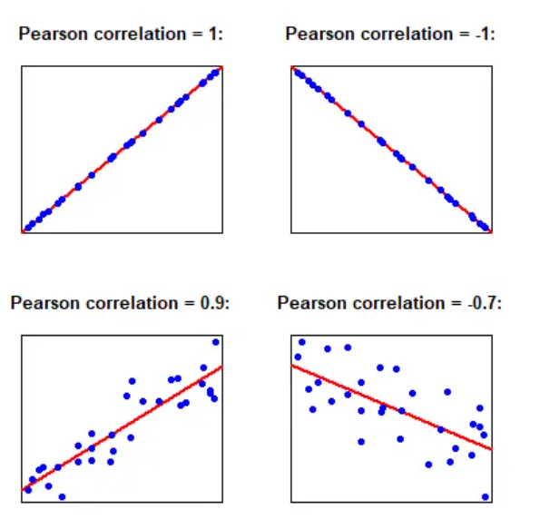
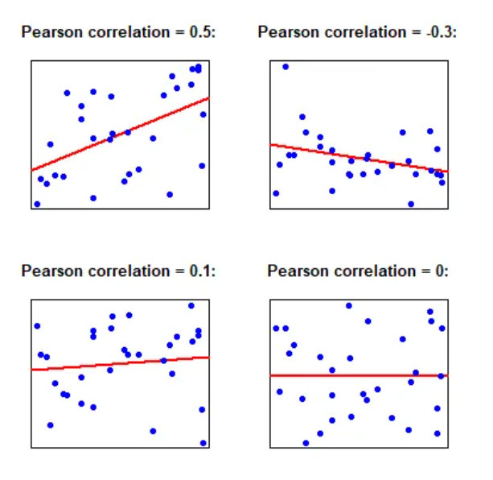
Coefficient of Correlation, r
r will represent the strength and direction of the relationship
Formula
Interpretation

Slide 4
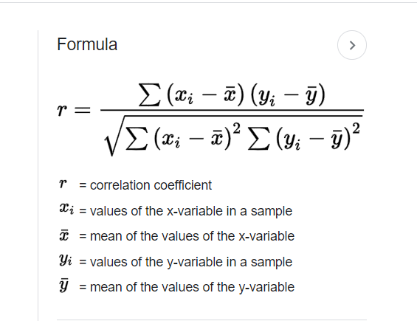
How to Calculate r (Pearson's Product Moment Correlation Coefficient)?
X | Y
100 | 9
105 | 8
90 | 5
80 | 2
80 | 4
85 | 6
87 | 4
92 | 7
90 | 6
95 | 7
93 | 5
85 | 5
85 | 4
70 | 3
85 | 3

Slide 5
What is the meaning of testing the significance of the correlation coefficient , r
Why? Is the linear relationship of a sample strong enough to model the relationship in a population?
How? The hypotheses
Null Hypothesis H₀: rho = 0, The population correlation coefficient IS NOT significantly different from zero. There IS NOT a significant linear relationship(correlation) between x and y in the population. Other words: correlation coefficient is not highly significant.
Alternate Hypothesis H_{a}: rho ≠ 0, The population correlation coefficient IS significantly DIFFERENT FROM zero. There IS A SIGNIFICANT LINEAR RELATIONSHIP (correlation) between x and y in the population. Other words: correlation coefficient is highly significant.

Slide 6
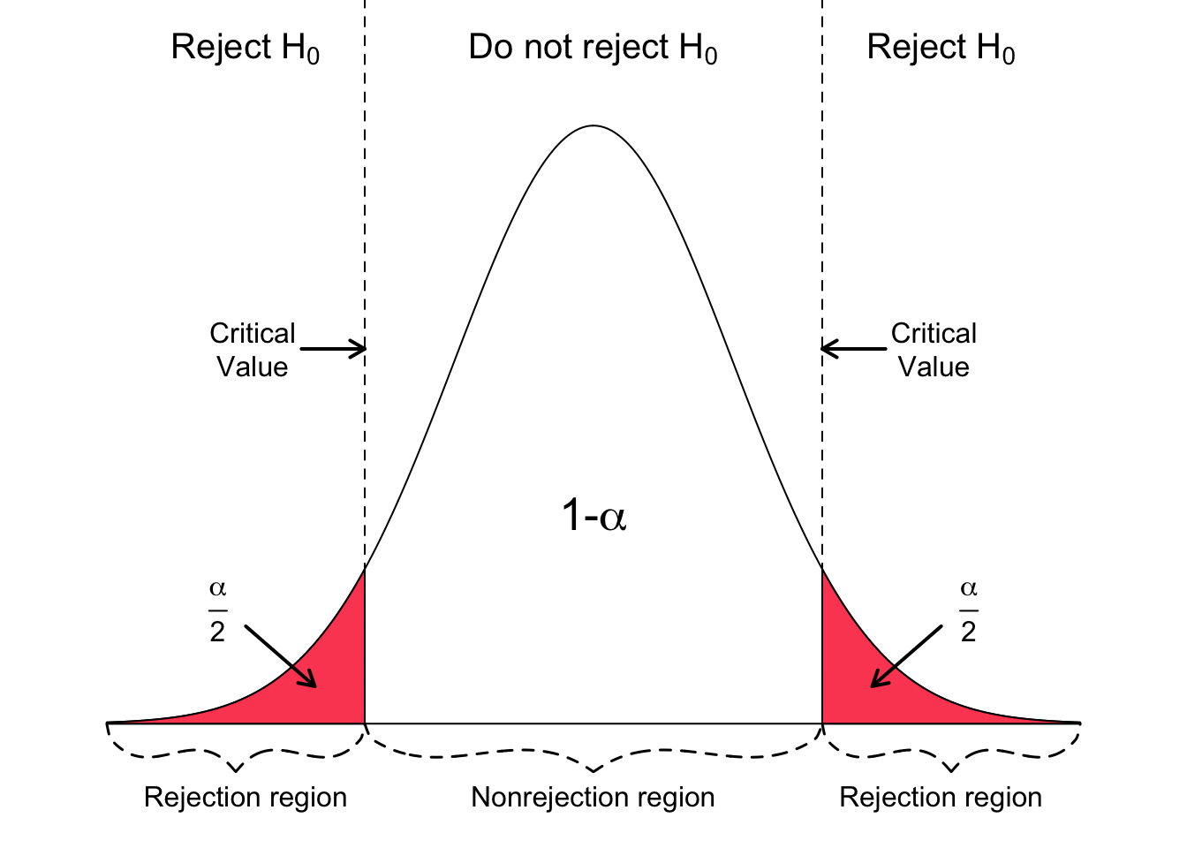
α value and p-value

Slide 7
Look at Pearson-r excel document

Slide 8
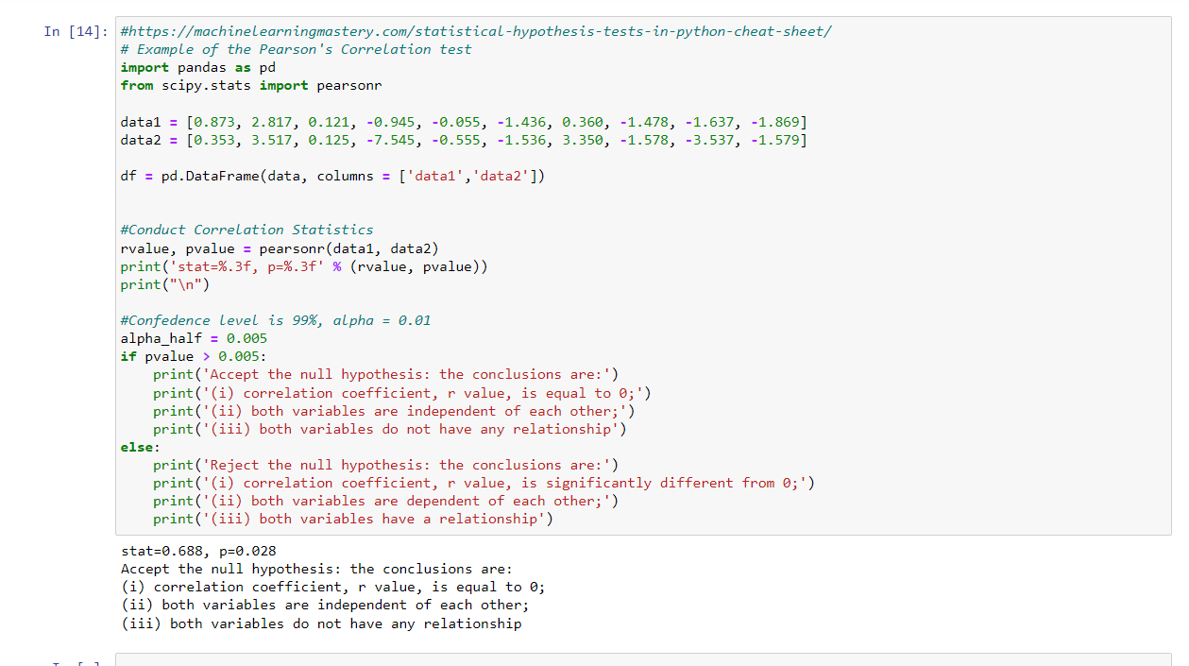

Slide 9
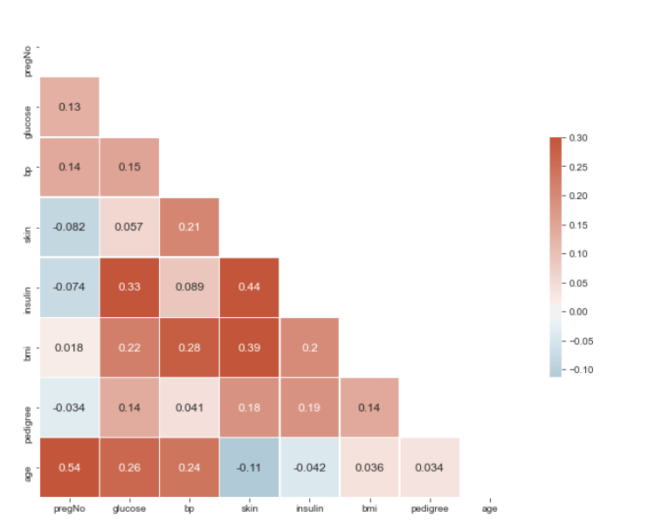
Correlation Heatmap

Slide 10
How to interpret?

Slide 11
Importance of correlation and input features
https://towardsdatascience.com/why-feature-correlation-matters-a-lot-847e8ba439c4

Slide 12
Chi Square Test for Categorical Data
To examine difference between categorical data
Example 1: (Owen and Jones, 1994)
Your task is to assess customers' preferences of 5 types of washing detergent: Zip, Whito, Acme, Blanco and Bleacho. You supply a small quantity of each powder in boxes marked A, B, C, D, and E to 1000 consumers. Ask them to test the detergent and state which they prefer.

Slide 13
Results of the survey
Washing Detergent | Zip | Whito | Acme | Blanco | Bleacho
No. Preferences | 187 | 221 | 193 | 204 | 195

Slide 14
Observed and Expected Frequencies
Observed (O) – obtained from survey
Expected (E) – based on null hypothesis
Product | Observed | Expected | (O-E) | (O-E)² | (O-E)² E
Zip | 187 | 200
Whito | 221 | 200
Acme | 193 | 200
Blanco | 204 | 200
Bleacho | 195 | 200

Slide 15
χ² = Σ(O-E)²/E
Product | Observed | Expected | (O-E) | (O-E)² | (O-E)² E
Zip | 187 | 200 | -13 | 169 | 0.845
Whito | 221 | 200 | 21 | 441 | 2.205
Acme | 193 | 200 | -7 | 49 | 0.245
Blanco | 204 | 200 | 4 | 16 | 0.080
Bleacho | 195 | 200 | -5 | 25 | 0.125
 |  | Σ | 0 |  | 3.500
χ²

Slide 16
Hypothesis Test
Chi-square is used to test hypotheses about the distribution of observations in different categories.
The null hypothesis (Ho) is that the observed frequencies are the same as the expected frequencies (except for chance variation). If the observed and expected frequencies are the same, then χ² = 0.
If the frequencies you observe are different from expected frequencies, the value of χ² goes up. The larger the value of χ², the more likely it is that the distributions are significantly different.

Slide 17
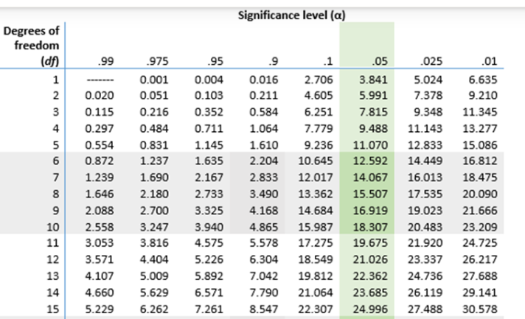
The Hypothesis Test
Degree of freedom, df = n-1 = 5-1 = 4
We choose a significance level, α = 0.05
Consult the Chi Square table https://www.scribbr.com/statistics/chi-square-distribution-table/
Χ² = 3.5
Critical value at α = 0.05 is *******
Accept null hypothesis – consumers are unable to distinguish between the washing detergents?
Reject null hypothesis – consumers are able to distinguish between the washing detergents?

Slide 18
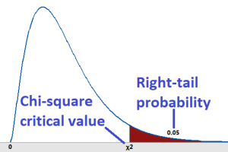

Slide 19
Example 2 – Contingency Table
 | Machine Output
 | Defective Articles | Non-Defective Articles | Total
Machine A | 25 | 375
Machine B | 42 | 558
Contingency Table
Dependence
What is Chi-Square Distribution for?
Look at excel sheet
Look at Yate's correction

Slide 20
Example 3 – Contingency Table
 | Decision
 | Yes | No | Neutral | Total
Female | 118 | 62 | 25
Male | 84 | 78 | 37
Contingency Table
Dependence
What is Chi-Square Distribution for?
Look at excel sheet

